Slide 1



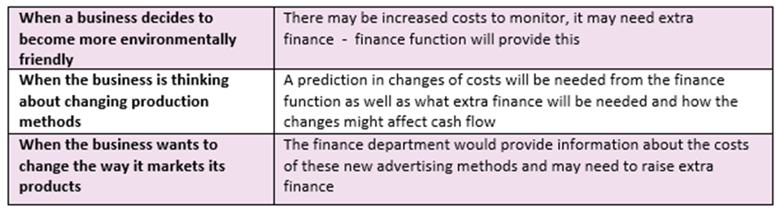


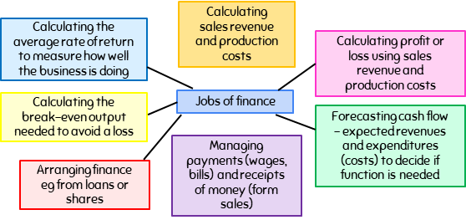






5.1 The Role of the Finance Function
Key Words
Finance Money raised and used by a business
Finance Function The area of business that provides financial information such as budgets and cash flow forecasts to support planning and decision making
Financial Information Includes details of profit, loss, cash flow, profit margin, average rate of return.
The Finance Function
When will financial information be useful in business decision making?
To support business planning and decision making
To provide financial information such as costs, revenue, cash flow
The “jobs” of finance
Summary
The work of the finance functions is important for decision making.
The finance function provides financial information about cash flow, spending on markets, break-even, production costs, profits and a comparison of costs.
Other departments also influence decision-making – it is all interconnected (relate to interdependent nature of business.
Quizizz - test yourself!
Quizlet
Exam Style Question
Video Links
Extended Reading

Slide 2
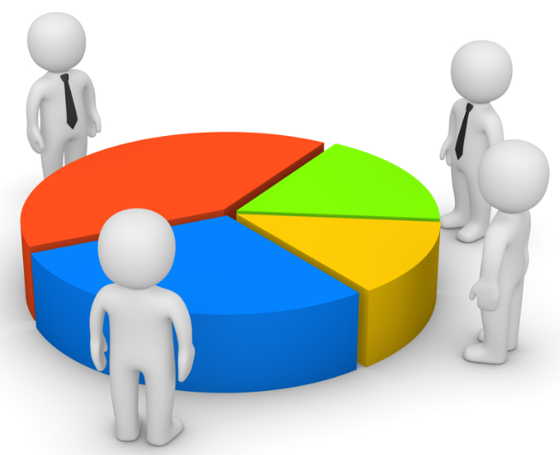
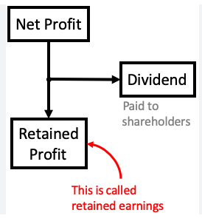
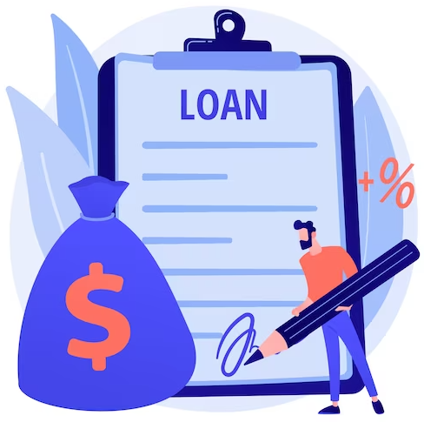
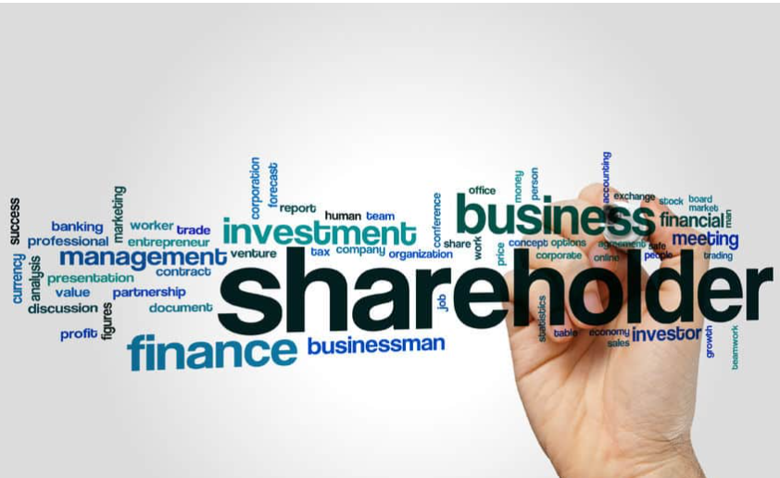
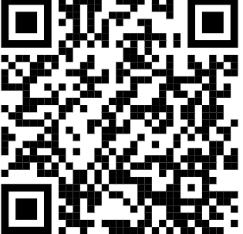
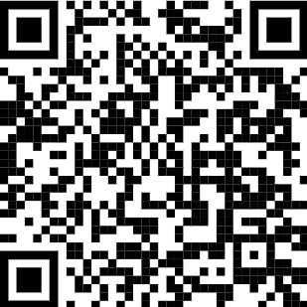
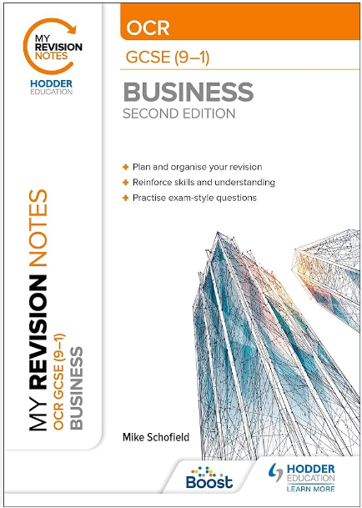

5.2 Sources of Finance
Key Words
Interest The amount of money that has to be paid back on borrowed money.
Sale of assets Items sold by the business.
Crowdfunding Funding a project by raising money from a large number of people who each contribute a relatively small amount, typically via the internet.
Overdraft An arrangement with the bank allowing a customer to spend more money than they have in their account.
Owner’s capital
Retained profit
Advantages
▪ No need to repay the money
▪No interest has to be paid
▪ No cost to raise the finance ▪ Readily available
Disadvantages
▪ The owner might not have enough savings to cover the whole finance
▪ May leave the owner short in personal situations
Advantages
▪ No interest has to be paid
▪ No need to repay the money
▪ No cost to raise the finance
▪ Readily available
Disadvantages
▪ Business might not have enough profit to cover the whole finance
▪ May leave the business short in the future in emergency situations
Loan
Issuing shares
Advantages
▪ Repayment is spread over time
▪ business knows exactly how much has to be repaid and when
▪ Money is available quickly
Disadvantages
▪ Interest has to be paid
▪ Business may need to risk an asset as security
▪ Bank will want to see a business plan to ensure they can afford the loan
Advantages
▪ A lot of finance can be raised from many investors
▪Money does not have to be paid back
▪ No interest is payable
Disadvantages
▪ Dividends may have to be paid to shareholders
▪Shareholders are entitled to have a say in the running of the business
▪The business may be taken over by a competitor
Bitesize - test yourself!
Quizlet
Exam Style Question
My Revision Notes OCR GCSE (9-1) p.86.
Video Links
Extended Reading
My Revision Notes OCR GCSE (9-1) pp.82-86.

Slide 3





5.3 Revenue, costs and profit
Key Words
Finance Function - The area of business that provides financial information such as budgets and cash flow forecasts to support planning and decision making
Financial Information - Includes details of profit, loss, cash flow, profit margin, average rate of return.
Revenue – Also called Turnover, Income and Sales. This is the money generated from selling your products
Fixed costs – costs that do not change as the level of production changes. They must be paid even if output/sales are zero, e.g. rent, rates
Variable costs – costs that change in direct relation to the amount sold or produced by a business, e.g. raw materials, packaging
Total costs – All costs added together
Profit – when revenue is greater than costs Loss – when revenue is lower than costs
Revenue & Costs
Profitability Ratios
Term | Formulae
(Total) sales revenue | Price x quantity
(Total) variable costs | Variable costs per unit x quantity
Variable costs (per unit) | Total variable costs quantity
(Total) fixed costs | Sum of all the fixed costs
Average fixed costs | (Total) Fixed costs quantity
Total costs | (Total) variable costs + (total) fixed costs
Profit/loss | Total revenue – total costs
Calculations using financial data to measure the performance of a business.
Gross profit margin | Gross profit Total revenue
Net profit margin | Net profit Total revenue
Average Rate of Return (ARR)
The average annual rate of return (profit) on an investment.
When a business invests in new equipment they want to know what the return is likely to be. Is it worthwhile investing in the new equipment?
Profit & Loss
Gross Profit - profit made as a result of buying and selling goods or services without the day to day costs of running the business.
Term | Formulae
Total profit from the investment | Total income received from an investment over a given period of time – cost of the investment
Average profit from the investment | Total profit from the investment Number of years
Average rate of return | Average profit from the investment Cost of the investment
Net Profit - profit made as a result of buying and selling goods or services including the day to day costs of running the business.
Gross profit | Total revenue – cost of sales
Net profit | Total revenue – cost of sales - expenses
Quizizz - test yourself!
Quizlet
Exam Style Question
Video Links
Extended Reading

Slide 4
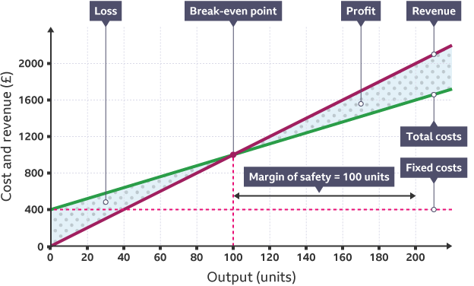

5.4 Break Even
Key Words
Break Even Point The break-even point occurs where: total revenue = total costs
Break Even Level of Output The number of units that a business needs to sell in order to cover their total costs from their total revenue
Margin of Safety The margin of safety is the difference between the current output level and the break-even point.
What is break even?
Simple calculation of break-even quantity
Break-even is the point at which revenue and total costs are the same, meaning the business is making neither a profit nor a loss.
Drawing a break-even graph can be time-consuming, but there is a simpler way to calculate the break-even quantity:
The result of this calculation is always how many products a business needs to sell in order to break even.
Usefulness of break-even in business decision making
Limitations of break-even in business decision making
New products – break-even can be used to predict how many units would need to be sold, and the business can judge whether this would be realistic.
Pricing – break-even can be used to see how different pricing strategies might affect the break-even point.
Costs – break-even can highlight the impact of changes in either fixed or variable costs.
Production levels – knowing how many units need to be sold in order to make a profit can help a business to plan production levels.
Break-even often uses forecasted figures and assumes that the business can sell the units that it produces. there are a number of things that might affect the forecasted break-even point.
Marketing activities – any marketing activities that involve price reductions will affect the total revenue received.
Changes in costs – the costs used to calculate the break-even point may not be accurate if they are based on forecasts.
Changes in external factors – a change in things beyond the control of a business can also affect the usefulness of break-even.
Quizizz - test yourself!
Quizlet
Exam Style Question
Video Links
Extended Reading

Slide 5


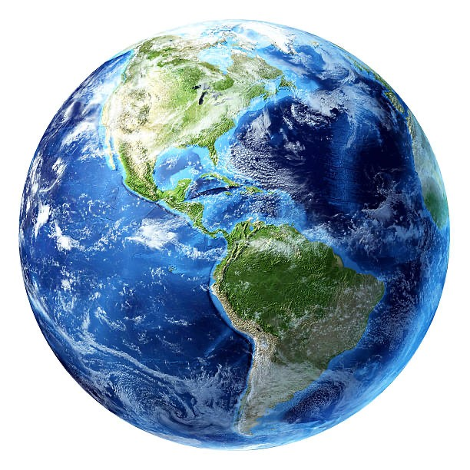






6.1 Ethical and environmental considerations
Key Words
Fairtrade A movement that encourages businesses to pay a fair price to suppliers in developing countries
Ethics What is morally right or wrong
Climate change The process when average temperatures rise or fall and patterns of weather change
Carbon footprint The total amount of greenhouse gases emitted through business activities
Environmentally-friendly Consumers and businesses that act to make production sustainable
What are ethical & environmental considerations in business?
Ethics
A business operating ethically aims to consider the following:
Business ethics is about how businesses make decisions that affect people or the natural world (the environment)
Being ethical can cause business costs to rise and short term profits to fall
Choosing between being ethical and maximising profit is known as a trade-off .
Ethical considerations are increasingly important to customers
Getting ethics right can lead to increased revenues and lower costs in the long term.
Workers
Paying employees fair wages and treating them well. This will increase employee retention
Customers
Not rip off customers by charging too much or knowingly selling inadequate products.
Suppliers
Paying suppliers a fair amount on time.
Choosing a supplier who is also ethical
Sourcing of materials
Sourcing ethical suppliers eg: Fairtrade
Ethical Marketing
Using honest and responsible marketing methods.
Environment
Businesses must consider the effect that their operations can have on the environment. By behaving ethically businesses could see an improvement in their brand image.
Sustainability
Can the resources they use be replaced? Use less fossil fuels and replace natural resources
Waste Disposal
Businesses should aim to reduce waste and recycle any waaste they do generate
Pollution
Businesses should reduce the amount of pollution ( air, water, noise) that they create
Climate change
Businesses may aim to reduce their carbon footprint and their emissions (less transport etc)
Quizizz - test yourself!
Quizlet
Exam Style Question
Video Links
Extended Reading

Slide 6



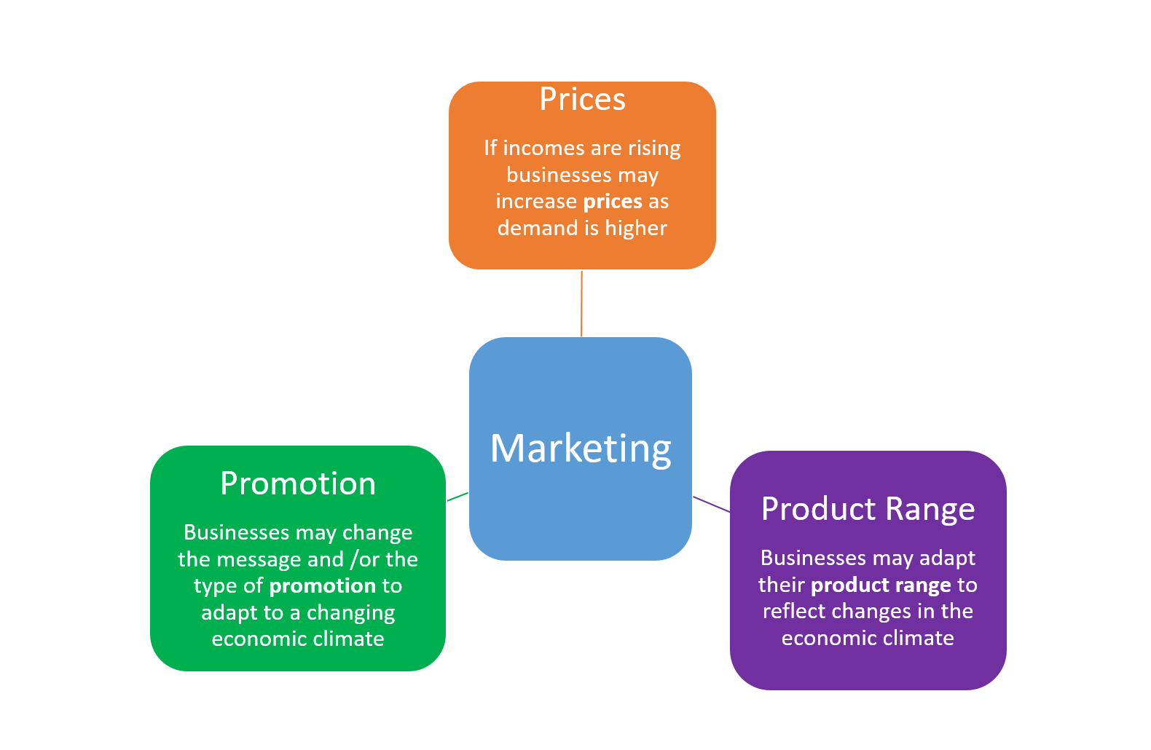






6.2 The Economic Climate
Key Words
Income The amount of money people receive from work and from assets that they own such as shares or property.
Economic Climate Refers to how well the country is doing in terms of the levels of income and employment
Customers Buyers of goods and services
Gross Domestic Product (GDP) A measure of the amount of goods and services a country produces. A rise in GDP indicates that the economy is growing and it is likely that incomes will rise too
Unemployment The number of people out of work in a country
Levels of consumer income
Levels of unemployment
If GDP in an economy is rising then levels of income, for many, will rise too. This influences the amount that people can spend. When incomes go up and people have more money to spend, businesses will generally sell more goods and services.
Lower levels of income means people generally have less to spend and may avoid purchasing non essential items.
If GDP falls, the economy may enter a recession. This means fewer goods and services are produced and levels of unemployment will rise. High levels of unemployment will impact on consumers’ incomes and how much they have to spend.
Business impacts from changes in the economic climate
Marketing
Human Resources
Finances
If GDP is falling then unemployment may rise as businesses are not producing as much. As a result there will be a bigger pool of labour for businesses to recruit from. Consequently, the wages offered may be lower, which means lower costs for businesses.
When incomes are lower, many businesses will suffer a loss of sales and therefore lower revenue and this is likely to impact on profits. Some may go out of business. However,this is not always the case and when incomes fall some businesses have increased their sales eg Aldi.
When sales are lower the finance department may look to reduce costs by improving cash flow and reducing financing/loan costs.
Quizizz - test yourself!
Quizlet
Exam Style Question
Video Links
Extended Reading

Slide 7
6.3 Globalisation
Key Words
Globalisation The process by which business activity around the world has become increasingly interconnected.
International brand An image or values for a product that are communicated in countries around the world.
Multinational companies Businesses that operate in different countries around the world.
International branding Businesses that sell in many different countries need to think about how they will market their goods and services in a way that will suit the local market – they need to create an international brand
Locating abroad Advantages: Lower production costs, l Supply of expert/skilled workers The business can be located near to the market (its customers).
Globalisation - how businesses are interconnected:
Globalisation has been made easier for the following reasons:
Global buying and selling
Global production
Global movement of people
Global movement of capital
Improvements to transport
Better telecommunications and the internet
Reduced trading barriers
Impact of globalisation on business:
Growth of multinational companies
Multinational companies (MNCs), such as Coca Cola and Google, are examples of globalisation. They operate in more than one country. The advantages to the business of being an MNC are:
Increased sales
Risk is spread
Lower costs
Tax avoidance
Growth of multinational companies
Influence on business location
International branding
How businesses compete internationally
Quizizz - test yourself!
https://quizizz.com/admin/quiz/5ec2fde728ea4d001b4e5bc0?source=quiz_share
Quizlet
Exam Style Question
My Revision Notes OCR GCSE (9-1) p.108.
Video Links
https://youtu.be/XwsbL4GF2RA
Extended Reading
My Revision Notes OCR GCSE (9-1) p.108.

